Slide 1
Global Trend in Industrial Refrigeration
Hernan Hidalgo
Global Account Manager – Danfoss Ind. Refrigeration
London Sep 30 2019

Slide 2
Agenda
01.
Refrigeration Systems developments
02.
Trends in NH3 charge
03.
Typical Industrial Refrigeration system types
04.
Trends in Industrial Refrigeration Systems
05.
Overview Transcritical cycle
06.
System Performance Comparison
07.
Systems Layout
08.
Defrost and Efficiency
08.
Oil return/recovery
09.
Conclusion

Slide 3
Why The Changes?
Industrial Refrigeration systems had enjoyed a higher degree of stability in terms of refrigerant choices.
Ammonia has been the predominant choice thanks to efficiency and heat transfer properties. Subcritical CO2 has been on the rise in Europe and North America
System Optimization has been key to development but also charge reduction in NH3 systems
In some developing economies, Urbanization is playing a significant role in the design and choice of refrigeration systems.
In some applications, Transcritical CO2 may be consider a good option.

Slide 4
01.
Refrigeration System Developments -Industry reaction
Blending in of technologies and systems
Definition of Industrial Refrigeration?
NH3?, CO2?, Steel?, Welding?, Capacity?, Pump circulation?
Typical NH3 systems
(steel/stainless,
welded connections)
Super low
charge
NH3/CO2
NH3/DX
Charge reduction
Sub segment
Multi stage pumped
Single pumped
Technology
Commercial CO2 transcritical sytems
Liquid ejector
gas ejector
Parallel compression
Booster
Single
CFC, HFC,HFO systems
HC
Capacity range
Up to 150 kW
150 – 500 kW
500-1000 kW
1000-10000 kW
> 10000 kW

Slide 5
02.
Trend to NH3 charge reduction
How to reduce NH3 charge ?
4 MW ammonia system
Charge: 5 kg / kW
20.000 kg
Documented risk assessment.
Offsite risk assessment.
Safety quick closing section valves.
Safety gas detection.
Etc.
Design system with a number of sub-segments, which can be separated from each other in the event of leakage.
Ammonia DX-system reduce the required liquid charge
Ammonia-CO2 cascade system or Ammonia-CO2 brine system
Install a number of rooftop mounted self-contained ammonia units
CO2 booster system
Increase general safety level of system.
A
Sub-segments
B
Ammonia-DX system
C
Ammonia-CO2
D
Low-charge Ammonia system
E
CO2 TC
F
Charge reduction is an attractive mitigation solution
Charge elimination
R717-charge
1 x 20.000 kg
(5 kg / kW)
R717-charge e.g.
4 x 5.000 kg
(5 kg / kW)
R717-charge e.g.
2 x 5.000 kg
(2,5 kg / kW)
R717-charge
~2.000 kg
(0,5 kg / kW)
R717-charge e.g.
8 x 200 kg
(0,4 kg / kW)
No R717-charge

Slide 6
04.
Industrial Systems
Variables to consider
System Design
Capacities: 1 to 5 MW / 300TR to 1500 TR
Performance and Efficiency
Maximum pressure ratings
Components availability
Efficiency of evaporators/system due to fouling. (e.g. Oil)
Operators and contractors learning curve

Slide 7
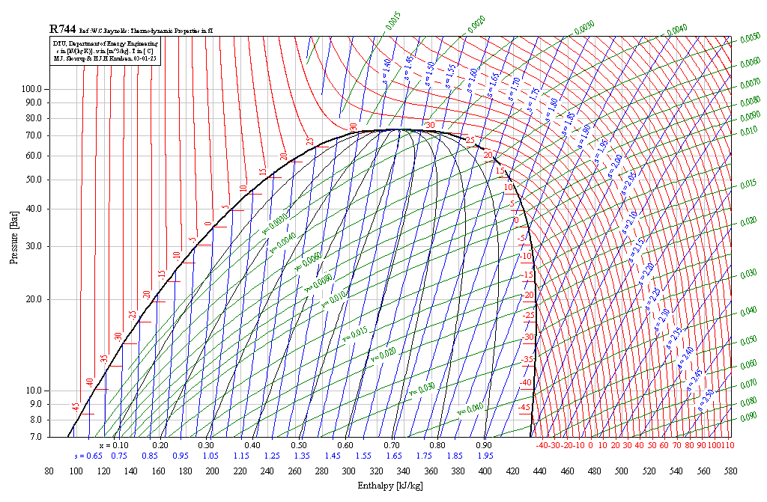
Refrigeration cycles with CO₂ - General Overview
TRANSCRITICAL
TWO-STAGE
COMBINED
SUBCRITICAL

Slide 8
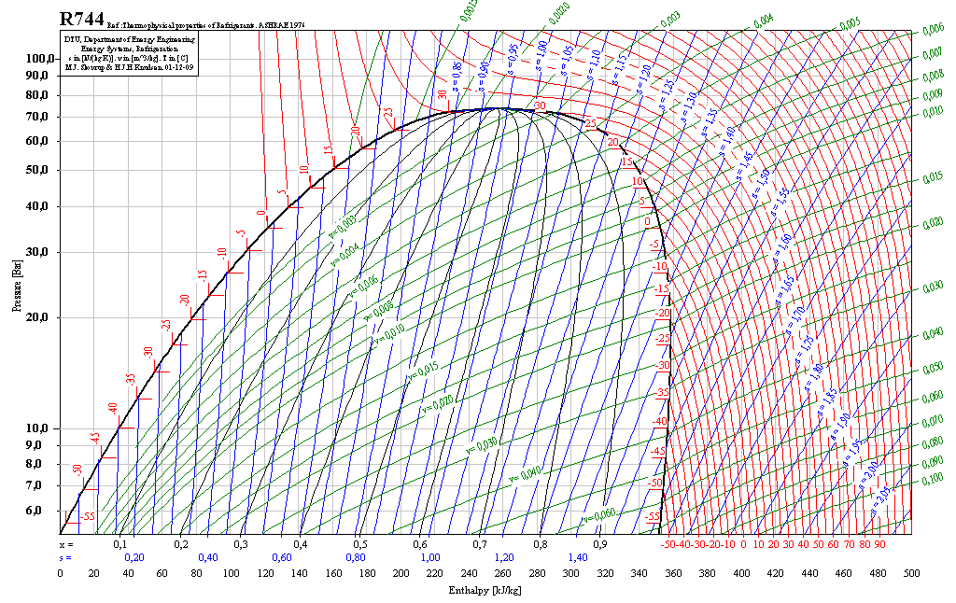
Transcritical refrigeration proces
Influence of compressor outlet pressure
35 ºC [95 ºF]
100 bar [1450 psi]
90 bar [1305 psi]
80 bar [1450 psi]
Max
Δh_{EVAP}
Δh_{Comp-is}
COP = 2,46
COP = 2,51
COP = 1,72
80
[1160]
90
[1305]
100
[1450]
bar
[psi]
COP = (Δh_{EVAP}*m )/ (Δh_{Comp-is}*m)

Slide 9
02.
Trend to NH3 charge reduction
Assessment of Emerging Systems Performance vs Traditonal
Fair Calculations have been made to provide an impartial assessment of industrial Ref Systems. (White paper presented at IRC Montreal 2019, Thomas Lund-Danfoss)
Two Stage R717, Pump circulation (2 Stage ) Baseline
R744/R717 cascade pump circulation
Transcritical R744 DX Operation
Transcritical R744 pump circulation
Two stage R507, Pump circulation

Slide 10
02.
Trend to NH3 charge reduction
Calculations performed on three different latitudes 365 day

Slide 11
02.
Trend to NH3 charge reduction
Compressor types used for calculations at different loads

Slide 12
02.
Trend to NH3 charge reduction
Power Consumption comparison with NH3 as a baseline
Dry cooler with no correction for parallel compression

Slide 13
02.
Trend to NH3 charge reduction
Power Consumption comparison with NH3 as a baseline
Bar graph TC flooded (recirculated) in warm climate does not include efficiency gain from parallel compression due to software constraints
 | CO2 TC DX | CO2 TC Flooded | R717 2ST | Cascade | R507 2ST
Rome | 129% | 121% | 100% | 105% | 106%
Frankfurt | 113% | 105% | 100% | 103% | 104%
Oslo | 108% | 100% | 100% | 103% | 103%
Table shows best possible results with adiabatic coolers and manual estimation with parallel compression for TC

Slide 14
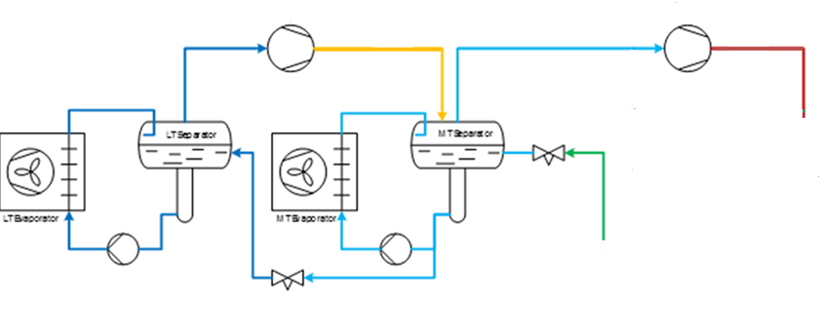
03.
Typical Industrial Refrigeration system types
The traditional NH3 pump circulation system
NH3
LT compressor
MT compressor
Condenser
100% ¹⁾
NH3 pump circulation
with Danfoss Industrial valves and controls
Fully dedicated IR built
Pumped systems on MT and LT
Dedicated compresssors per temperature level
Evaporative condensor
Industrial hotgas defrost
Oil return control
Complete system coordination
Steel/stainles steel pipes
Welded
Industrial built design
Reliabile and proven technology
+
Generally most efficient system
Superior cooler efficiency
Easy to control
Efficient and safe hotgas defrost
High safety integrity
Leak tight
Long litefime
New emerging technologies for charge reduction
-
NH3 charge
First costs

Slide 15
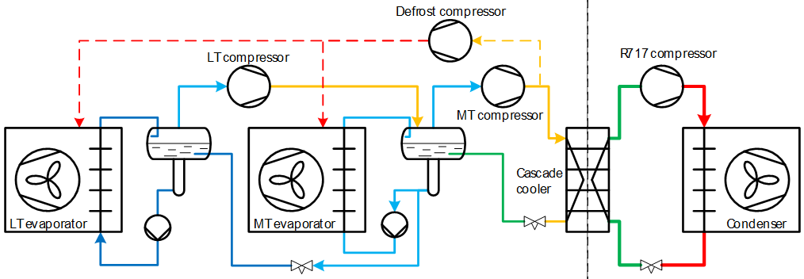
03.
Typical Industrial Refrigeration system types
NH3/CO2 cascade system
Achieved with standard components rated at 754 psig
CO2 sub critical
NH3
CO2 pump circulation
Fully dedicated IR built
CO2 pump systems on medium temp. and low temp.
Dedicated compresssors per temperature level
Evaporative condensor
Industrial hotgas defrost
Oil return control
System coordination
Steel/stainles steel pipes, welded
Industrial built quality
Reliable and proven technology
+
Up to 80% NH3 charge reduction
High efficienty compared to brine systems
Small CO2 compressor foot print
CO2 liquid overfeed
Superior cooler efficiency
Easy to control
Efficient and safe hotgas defrost
High safety integrity
Leak tight
Long litefime
-
Higher pressure
Cascade cooler

Slide 16
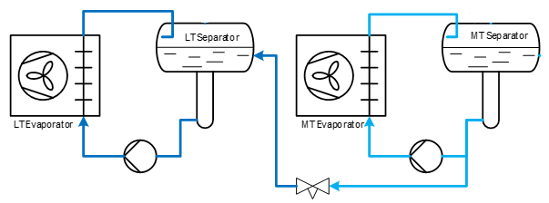
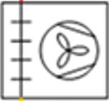
04.
The Industrial CO2 TC system
Ie 1-5 MW
Pump circulation and hotgas defrost
CO2 sub critical
CO2 (transcritical)
LT
MT
IT
MT pumps
LT pumps
Ejector
IT seperator
CO2 pump circulation
Multiple racks parallel connected
Fully dedicated IR built
Pumped systems on MT and LT
Possibly DX on LY
Parallel compresssion
Air cooled gas coolers
Industrial hotgas defrost
Oil return control
System coordination
Gas ejector
Steel/stainles steel pipes, welded,
Industrial built
Stand still pressure 65 bar
+
No NH3
No superheat, so better efficiency
compared to CO2 TC DX
Better HTE
Better cooler efficiency
Easy to control
Efficient and safe hotgas defrost
High safety integrity
Leak tight
Long litefime
-
Less efficient compared to NH3
Racks:
Need many racks
Life time
Serviceability
Commercial compressors
Complex HP control system

Slide 17
04.
The industrial CO2 TC system
The key elements
Subcritical
Connection
Transcritical
LT
MT
IT
HP valve
AK-PC 782A
IT seperator
MT pumps
LT
LT pumps
MT
1) Industrial valves (2 temp. Levels, LT)
IT
AK-PC 782A
HP valve
IT seperator
LT
Rack controllers, MT and LT
MT
IT
AK-PC 782A
HP valve
IT seperator
LT
MT
AK-PC 782A
IT
HP valve
IT seperator

Slide 18
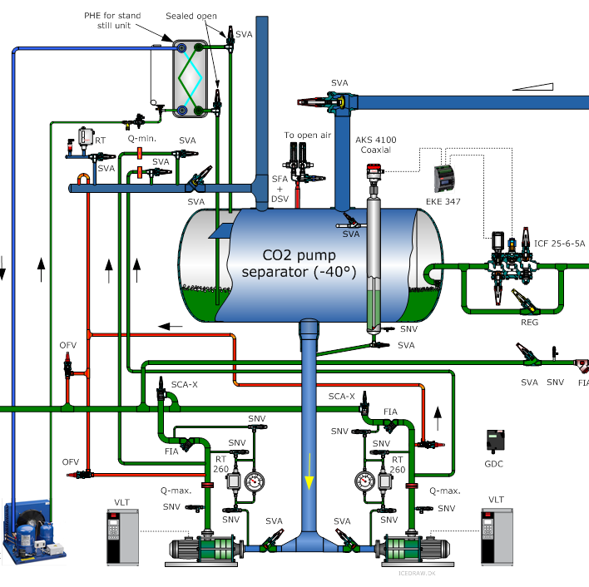
06.
Industrial Pumped System
Level Control of recirculators – Similar to NH3 systems
Static Height
Calculations dffer from those in NH3 systems
Communication. Integration with central compressor package controllers and evaporators is key to balance the system

Slide 19
06.
Industrial Pumped System
Hotgas defrost is by far the most efficient method compared to
Electric defrost: ~ ¼ of the efficiency
Glycol interlace: ½ of the efficiency

Slide 20
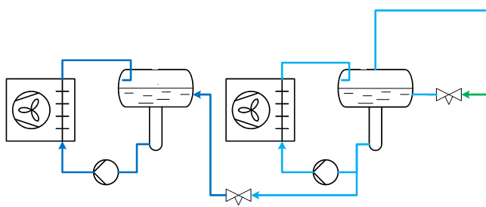
06.
Danfoss Industrial Pumped System
2c) Hotgas supply for defrost
Sub critical pressures
Transcritical pressures
Industrial pump circulating system typical PS = 52 bar
Downstream pressure control
Trancritical racks typical PS = 120-140 bar
PC L
PC MT
LT
MT
LT separator
MT separator
IT
MT
evaporators
LT
MT
The pressure in the sub critical system must be controlled
ALWAYS Focus on controlled and safe injection
Controlled defrost pressure between 7-12 degr.C
Take care of long lines and pressure loss (1 bar ~ 1 K)
Hotgas supply pressure to be controlled
Back up safety needed (internal pressure relief)
Final safety: external pressure blow off
IT
LT
MT
IT

Slide 21
06.
Industrial Pumped System
2d) Oil rectify – and oil return control
Sub critical pressures
Transcritical pressures
Industrial pump circulating system typical PS = 52 bar
Trancritical racks typical PS = 120-140 bar
PC L
PC MT
LT
LT separator
MT separator
MT
oil
MT
evaporators
System oil
IT
Purpose
Send accumulated system oil back to the racks
gas ejector
How ?
Oil rectifying system
IT seperator
CO2 TC rack 1,2,3,4,5
What to control?
Oil rectifier injection control
Oil collection receiver pressure
Oil circuit back to racks
Oil need signal frtom racks
Safety
Oil rectifier
Receiver
pressure
P
TC
oil
Oil
return
Liquid injection

Slide 22
Conclusions
09.
1
NH3 (ammonia) is still the most efficient refrigerant for Industrial Systems going forward
7
The connection of the Industrial pump systems to a transcritical cycle world however demands some industry efforts
2
NH3 charge reduction (at same or better efficiency) remains an obvious goal and offer a significant lower regulatory burden
8
OEMs are investing in solutions to make these systems easier accessible
3
NH3/CO2, NH3 low charge or CO2 TC systems are possible options.
9
Larger transcritical CO2 compressor capacities are critical for further development of CO2 TC applications in Industrial Refrigeration
4
Commercial and Industrial CO2 TC systems are different-both due to different performance, lifetime, reliability and safety expectations!
The viability of CO2 TC Systems in Industrial Refrigeration applications should become more clear in the next few years.
10
5
Transparent comparison of energy efficiency of different system types is extremely important!
6
CO2 transcritical pump systems close the gap for mid size plant capacities when NH3 is not considered in the first place

